Slide 1
Problem Statement: Ticket-less Entry System to Monuments/Museums
Team name: Outlaws

Slide 2
Project Name : BANJARA
Idea/Approach
●Our solution includes a QR-based e-ticketing application that makes booking tourist attractions a breeze.
●The first option in our app is to select a tourist attraction and book it straight from anywhere and at any time.
●The second option provides a scanner that can be used to book tickets directly from the location
●Every tourist place & ticket will have unique details by which you will be allowed to enter.

Slide 3
ADDITIONAL FEATURES
Additional feature of prediction of expected crowd at the place.
Suggest Underrated Paradises of the Area.
Description of the Places.
An opportunity for Local Guides.
Will tell you estimated time of entry.

Slide 4
Technology used:
●Front-end : Kotlin/HTML5, CSS3, JS
●Intermediate : PHP
●Back-end: MySQL
●QR technology
●QR validation API

Slide 5
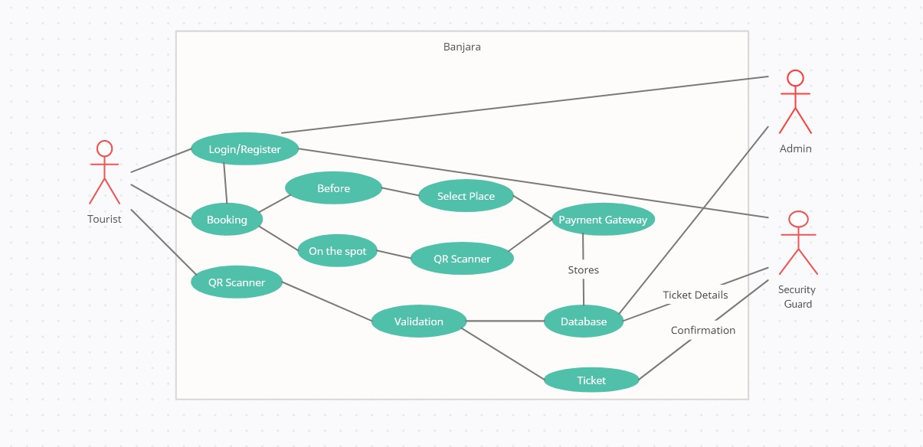
USE CASE

Slide 6

BUSINESS MODEL
We will have contracts with the administration of all the tourist attractions listed in the app, and we will receive a percentage of each ticket sold.
Creating Employment for local guides and reducing scam rates.
Standing up for the motto “Atithi Devo bhava”

Slide 7
SCOPES OF INCOME
Promotional Contracts
Commission from Local Guides.
Google ads (if required)
Sponsors from the heritage/museum

Slide 8
THANK-YOU

